Slide 1
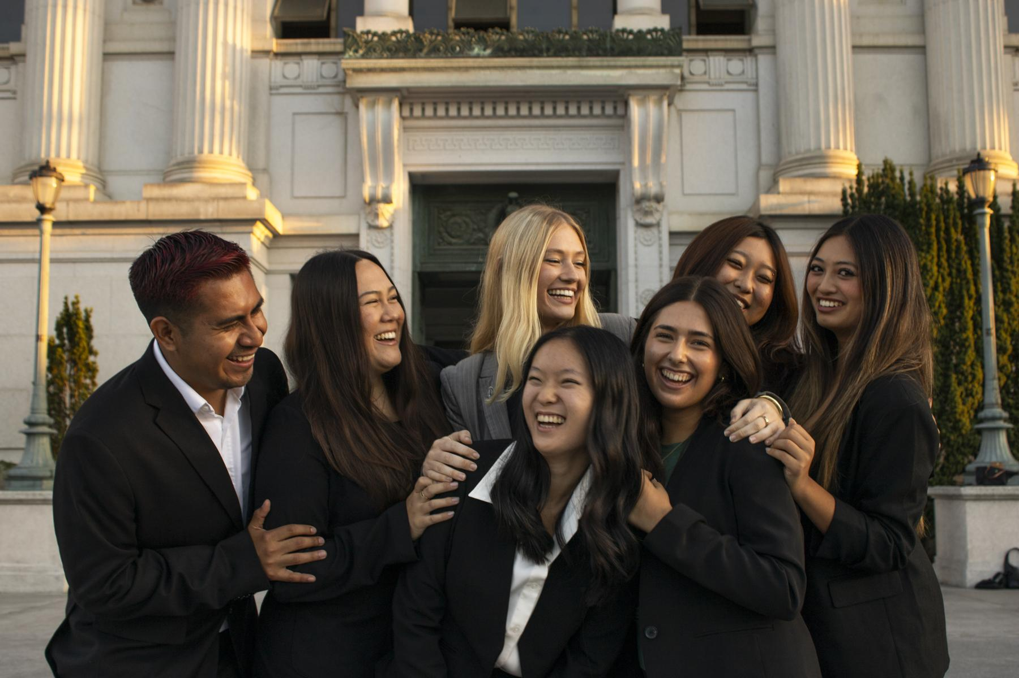
CPO
Senate Updates
12/3
Chief Personnel Officer Shelby Coleman
personnel@asuc.org

Slide 2
Misc. What I’ve been up to!
GovComm
Admin Office Oversight Committee will convene next semester, ongoing hiring process for Admin Office Asst. Manager
Reappointed to CPO #thanks, SR25/26-015
Winter Conference bCals coming soon – early next semester
ASUC Executives, Appointeds & Board of Directors Nimble Strategy 12/10 6:30 – 8:00pm (Abby sent bCal)
*Normal attendance policies apply – mandatory

Slide 3
Closing out the year (what I’ve really been up to)
Final call for was 11/30…
All stipend PRs in from Senators - thank you!
Volunteer forms still outstanding, manually sent names
  CalLink issues – OASIS, DuoPush (Berkeley IT)
Missing reports, check self-tracker
No deadline - need now
Stipend reconciliation beginning

Slide 4
10 Executive + Appointed Officials and offices
20 Senators + offices
1 TSR + office
2 Ad-Hoc Committees
2 Councils
8 Commissions
Chartered Programs
Projecting 1350 members of the ASUC!

Slide 5
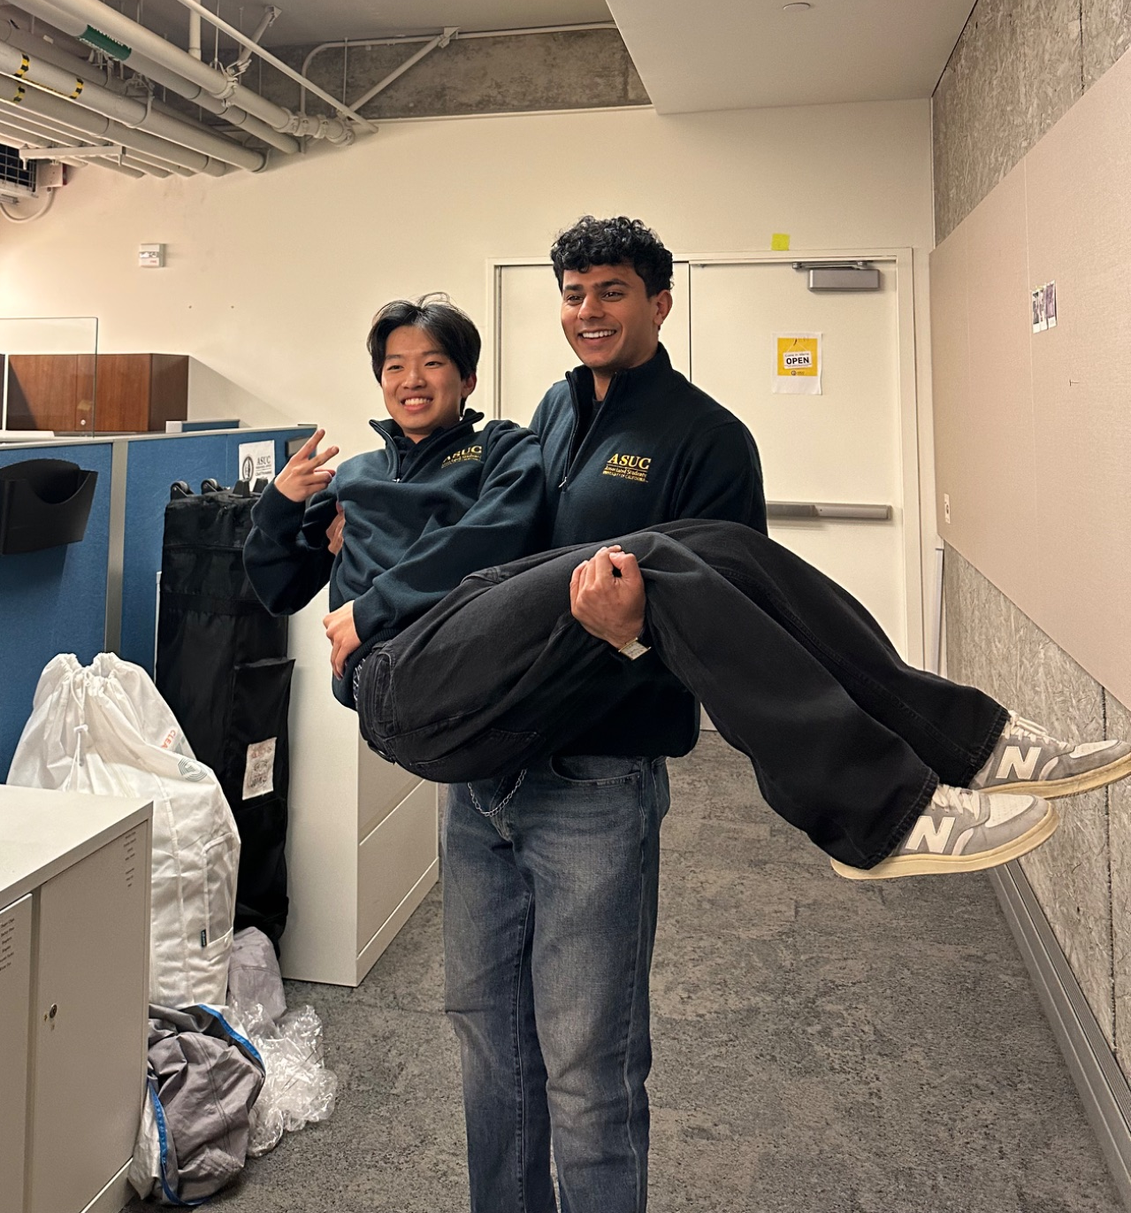
​​Thanks
Email personnel@asuc.org
Misc reminders
Email over text
Use your ASUC emails!

