Slide 1
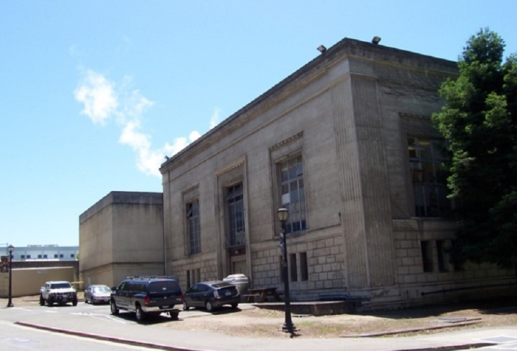
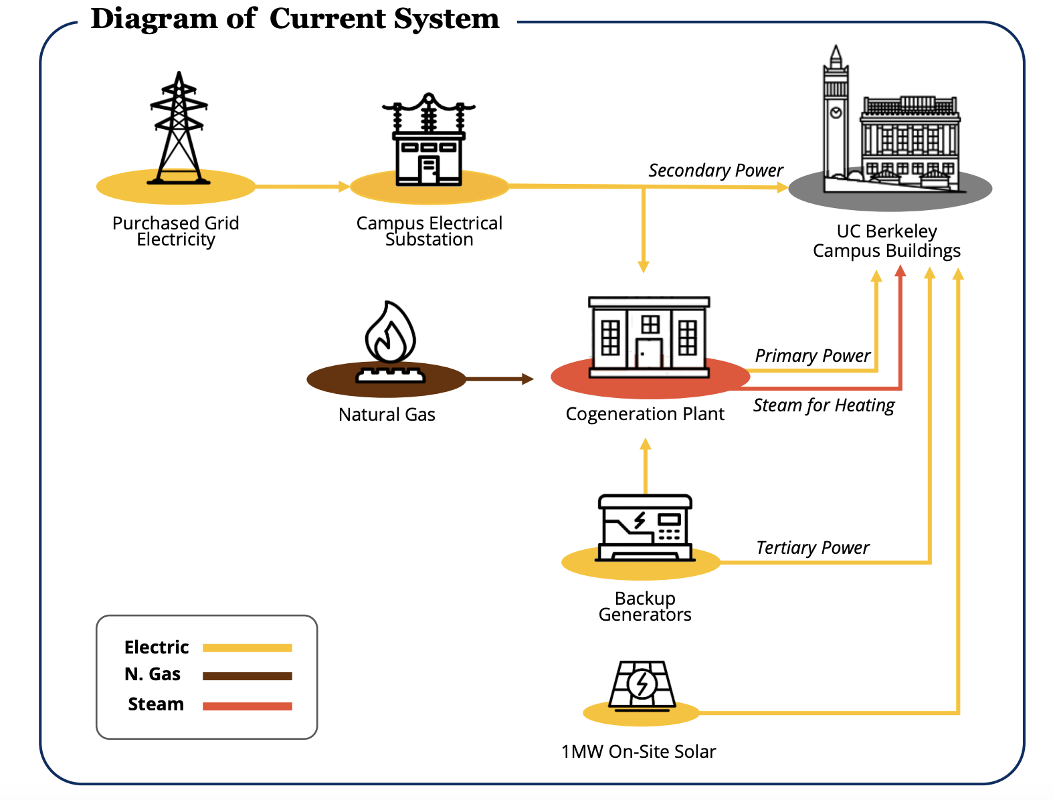
Context of the Cogeneration Plant
Cogeneration plant built in 1987
  Initially provided 100% of the campus’ energy needs
  Since expansion only provides ~80%
It is powered by fossil gas combustion - natural gas
Produces electricity & heating for the campus building
Located on Southwest side of campus between Evans Diamond and the Eucalyptus grove
When built it was a state of the art energy plant but now the system is long overdue for renewal
  Outdated and inefficient
39 years old - nearing end use of life
  Most cogeneration plants have a lifespan of 20-30 years
In 2019, 71% percent of total campus emissions (134,900 metric tons) came from the plant
Notes:
At the center of Berkeley's current energy system is a natural gas-fired cogeneration plant, which is the primary source for electricity and heating for campus buildings and you’ve probably noticed it located on the Southwest corner of campus. When it was first built in 1987, the cogeneration plant was state of the art facility, efficiently producing both electricity and steam.
Emissions from the fossil fuel used in the cogeneration plant system contribute to the majority of the campus' scope 1 greenhouse gas emissions and remain the biggest challenge to achieving the university’s 2045 goal of reducing emissions by 90 percent.
The cogeneration system was originally designed to power the entire campus and was constructed almost 40 years ago, so it is now inadequate to meet the campus' growing energy needs and incurs increasing operating costs under California's cap-and-trade regulatory framework.
As a result, the campus has increasingly relied on the local utility for additional power to keep up with growth. With the cogeneration plant and steam distribution system nearing the end of its useful life, maintenance and needed upgrades have become increasingly disruptive and cost prohibitive.

Slide 2
Clean Energy Campus History
1
2015-2020: Evaluating Options
2
July 2021: Launch of Project
UC Berkeley launches the Berkeley Clean Energy Campus (BCEC) Initiative
Initiation of Integrated Resource & Activation Plan (IRAP, finished in May 2024)
Aging cogen plant identified as an issue
ARUP brought in to evaluate potential options
Three broad proposals: 1) keep existing cogen plant but refurbish 2) partially electrify campus 3) completely electrify campus
4
June 2022: State Funding- $249 million
3
January 2022: Clean Energy Campus Committee
Incredible student engagement and action, combined with Office of Sustainability administration, support secures $249 million for BCEC
Final commitment to electrifying
Formation of Clean Energy Campus Advisory Committee to plan and design BCEC project
Involves faculty, student and administrative representatives
6
July 2025: UC Regents Approve Phase 1
5
July 2023: UC Regents Approve Funding
Big Beautiful Bill transitioned state funding to debt financing - released in segments over the years
UC Regents approved Phase 1 project scope + design + adopted CEQA findings allowing construction to begin
Construction to begin mid-2026 (~June)
The University of California Board of Regents approve $40 million funding for pre-construction designs and plans for BCEC
Notes:
2015-2020: Aging cogen plant identified as an issue, so ARUP, the consulting group, was brought in to evaluate potential options. There were many different options proposed but in the end Berkeley decided to go fully electric! Then in 2021: Berkeley officially launches the Berkeley Clean Energy Campus (BCEC) Initiative and initiates the Integrated Resource & Activation Plan (IRAP)
January 2022: Final commitment to electrifying and forming Clean Energy Campus Advisory Committee to plan and design BCEC project, committee has faculty, student and administrative representatives
June 2022: Incredible amount of student engagement and action, UC Green New Deal, BERC, ASUC resolutions, petitions, letters, etc. sent to CA State Finance Committee, combined with Office of Sustainability administration, secures $249 million for BCEC
July 2023: The University of California Board of Regents approve $40 million funding for pre-construction designs and plans for BCEC
The $249m in state funds are strictly allocated for capital projects & cannot be redirected to other budget items such as academics and will be funded through debt financing in increments over the next 10-20 years.

Slide 3
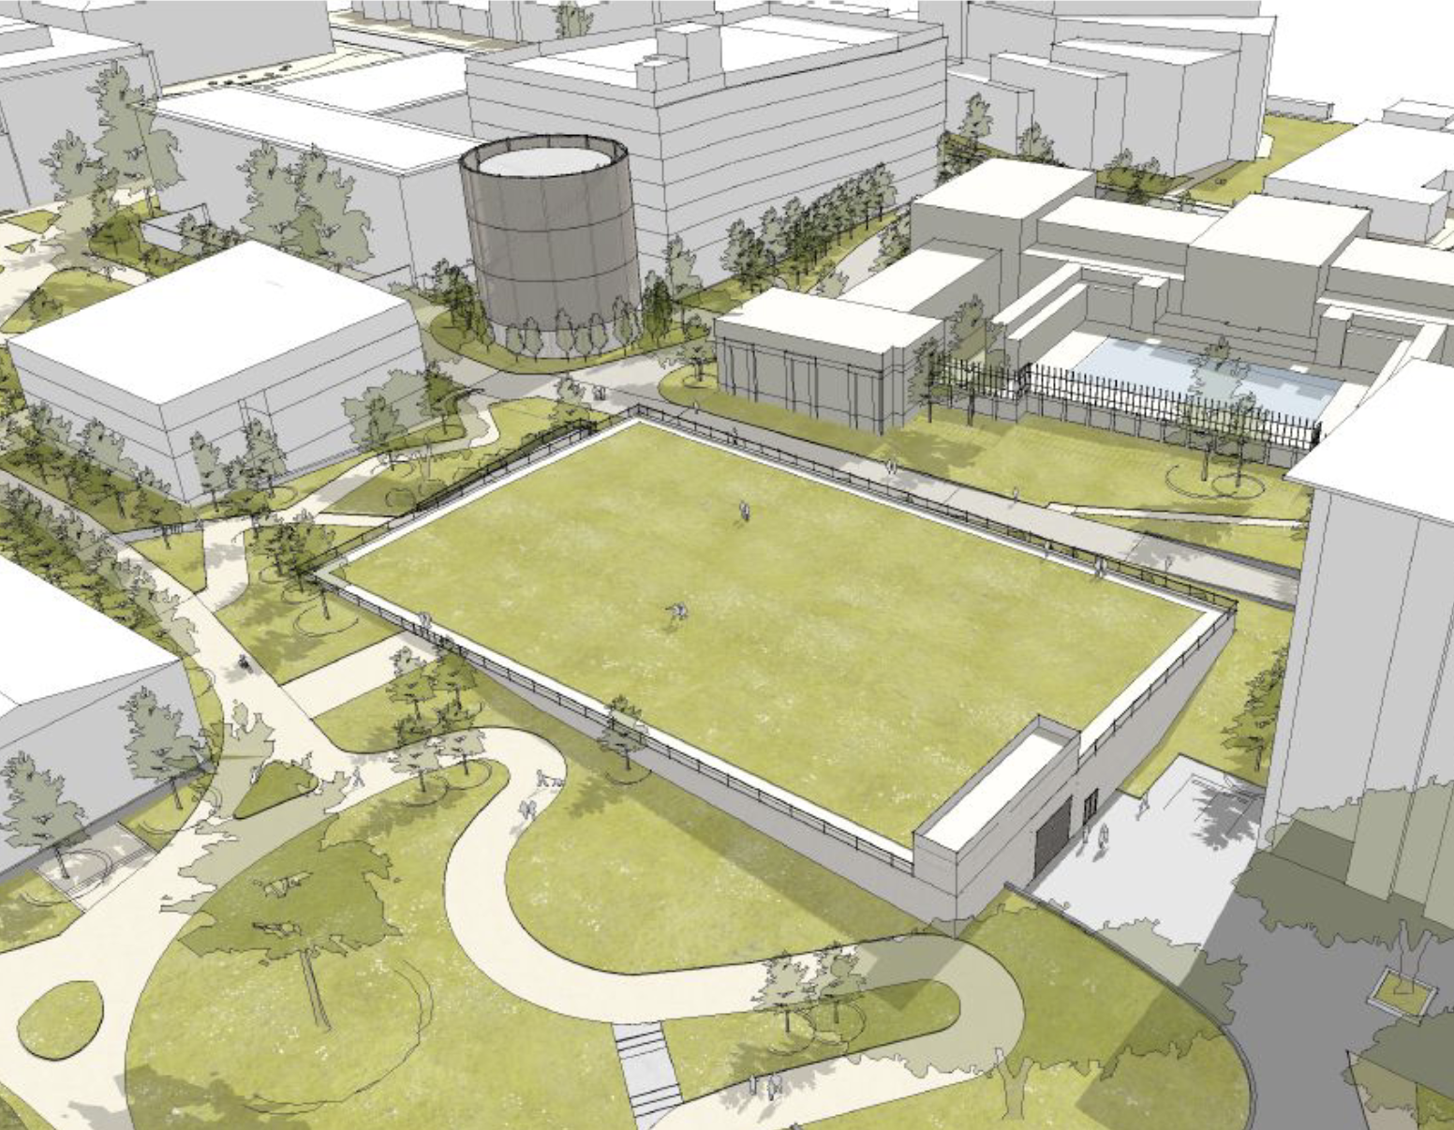
Electric Heating and Cooling Plant + Thermal Energy Storage
Centralized Electrified Heating and Cooling Plant:
state-of-the-art facility accommodating advanced, energy efficient technologies including heat recovery chillers and thermal energy storage
Thermal Energy Storage System:
one 85ft water tank totaling over 2 million gallons that will capture excess heat during periods of low demand and store it for periods of high demand
EHCP can satisfy 80 percent of the campus heating energy currently provided by steam, by capturing and reusing waste heat from across the campus
This plant will provide heating and cooling to existing and new campus buildings through efficient hot and chilled water distribution piping and will be powered by 100 percent clean electricity.
Notes:
The EHCP will be located on north field between social sciences and morrison library with heart gym on one of it’s vertical sides. It will provide heating and cooling to existing and new campus buildings through a hot and cold water piping system and will be powered by 100 percent clean electricity. There will also be this 85 foot thermal energy storage tank to hold that water and it will definitely be visible. Once the EHCP is finished, the field will be put back on so it can be used for sports and various activities.

Slide 4

Timeline for Implementation
Construction Begins
Cogen Shut-down
Boiler Shut-down
`
`
`
2024
2025
2026
20262027
2028
2029
2030
2031
2032
2033
2034
2035
(N) EHCP: Design - Planning & Funding
(N) EHCP Construction: Groups 1, 4 & 6
(N) CUP
(N) EHCP Capacity Expansion: Groups 2, 3 & 5
(N) EHCP Capacity Expansion: Cooling Conversions)
(N) EHCP Capacity Expansion: LRDP
Piping Distribution
Piping Groups 1, 4 & 6
Piping Distribution: Groups 2, 3 & 5
Building Conversions
Bldg Conversions: Groups 1, 4, & 6
Bldg Conversions: Groups 2, 3, & 5
Existing Building Cooling Conversions
(E) Cogen: Boiler Upgrades
(E) Cogen: Decommissioning
(E) Cogen
(E) Boilers: Decommissioning
DERs: Phase 1 (15 MW)
DERs
DERs: Phase 2 (+10 MW)
ELECTRICAL
Substation: Possible Upgrades
Ductbank Upgrade
Phase 1
Phase 2
Phase 3
Notes:
So just a quick timeline. phase 1 will officially start in mid 2026 so in just a couple months and it will connect the top half of campus while the bottom half will stay connected to the cogeneration plant
Then as phase 2 starts in late 2028 early 2029, the cogeneration plant will shut down and phase 2 buildings will be connected. Once that happens, the boiler will shut down in late 2030 which is when phase 3 will start where more distributed energy resources such as fuel cells or battery storage or solar will be added on
Currently the design stage has been finalized and the construction development stage is almost finalized so once that’s completed construction can begin in mid 2026

Slide 5
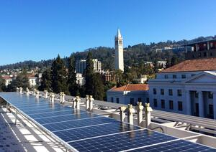
Why This Project Matters for UC Berkeley Student Body
Ongoing construction will affect campus accessibility for at least 2 years(digging for piping replacements, 85 foot 8 million gallon water tank, building upgrades)
Building clean infrastructure that ensures a fossil-free future for years to come
Also introduces new challenges like resilience and ability to power school without extended grid reliance
Notes:
Finally, this project matters for the UC Berkeley student body because it will be a huge infrastructure overhaul with construction affecting the entire campus. These disruptions will be extremely apparent starting this fall already and there is currently a plan in place for student communication but we are still unsure what that looks like so we would really appreciate senator support on that as it begins shortly. This project will power our campus for the next 50-100 years so it is a super important and huge undertaking. Thank you.

