Slide 1

ASUC Office of the President Senate Announcements
Wednesday, Sept. 17th

Slide 2
Events/Committee Meetings
ASUC & GA CalMessages Protocols 9/15
Naming Advisory Task Force Committee 9/15
Campus Memorial 9/15
Black Caucus 9/15
OP Exec Meeting 9/15
ExComm 9/15
University Writer, Amy Cranch 9/16
Equity & Inclusion Meeting for the MCC (VC Mejia, Elisa, MCC ED Antmen Mendoza) 9/16

Slide 3
Events/Committee Meetings
Senator Abnusy x ISCO Candlelight VIgil 9/16
Latine Caucus 9/16
UC Regents Public Comment 9/17
UC Council of Presidents 9/17
ASUC Execs & Appointeds 9/17

Slide 4
Upcoming Meetings/Events
First All-Staff tomorrow! 9/18
Cal Alumni Association Board Members Meeting 9/22
Standing Meeting, Chancellor & VPAP Chiefs of Staff x GA 9/22
Builders of Berkeley Touch Base Meeting 9/23
Connecting with CalDining Executive Director
Minority Serving Institution legislation

Slide 5
Office of the President Events
OP Alumni Homecoming Event 10/3 (RSVP!)
Notes:
Isa

Slide 6
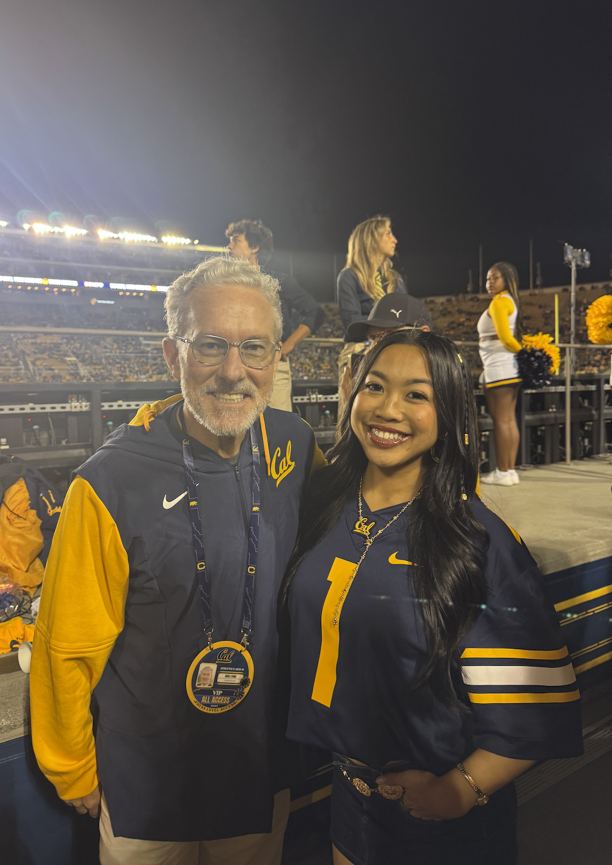
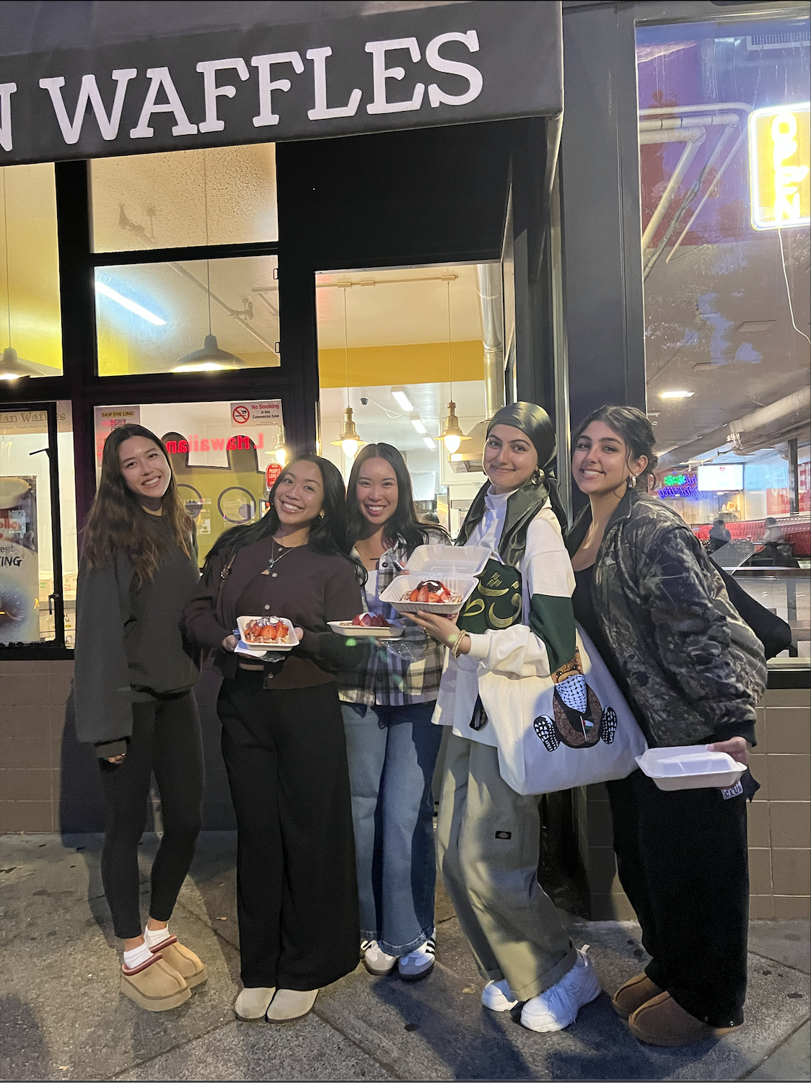
Highlights

Slide 7
Questions?
Contact: president@asuc.org
bCal: abigailverino@berkeley.edu

