Slide 1

ASUC Office of the President Senate Announcements
Wednesday, Nov. 19th

Slide 2
Updates
Groceries w/ Berkeley Student Food Collective
Two student deaths in one week

Slide 3
Past Events Upcoming Events
Student Union 11/13
APO’s Legal Panel 11/13
ASUC x VPUE x Registrar 11/17
ASUC x VPAP 11/17
AVC Chief of Staff 11/17
Council of Presidents 11/17
Transfer Social 11/18
People’s Park Collab with OP 11/18
CASSA Advisory Committee 11/19
ASUC Latine x Pilipinx Mixer 11/19
CACSSF Meeting 11/21
Danceworx Filming 11/21
SU Monthly Board of Directors Meeting 11/21
Bonfire Rally 11/21

Slide 4
OP Events
Pie-the-President Birthday Fundraiser
  Friday 11/21, 12:00 - 2:00 PM on Upper Sproul
OP Insomnia Cookie Social
  Tomorrow (11/20)
Peoples Park Panel
  November 18th 4-6:30PM (yesterday)
Transfer Student Churros & Chill Social
  Tuesday, November 18, 2025 (6:30 p.m. - 8:00 p.m.) (yesterday)

Slide 5
Action Items
Nimble Strategy Sessions
CHALLENGE #1: LIMITED FINANCIAL RESILIENCE
CHALLENGE #2: INADEQUATE SUPPORT FOR STUDENT SUCCESS
CHALLENGE #3: INFRASTRUCTURE UNDERINVESTMENT UNDERMINES MISSION
CHALLENGE #4: DIMINISHING CONFIDENCE IN BERKELEY’S VALUE
CHALLENGE #5: NAVIGATING AI'S IMPACT ON LEARNING AND SCHOLARSHIP

Slide 6
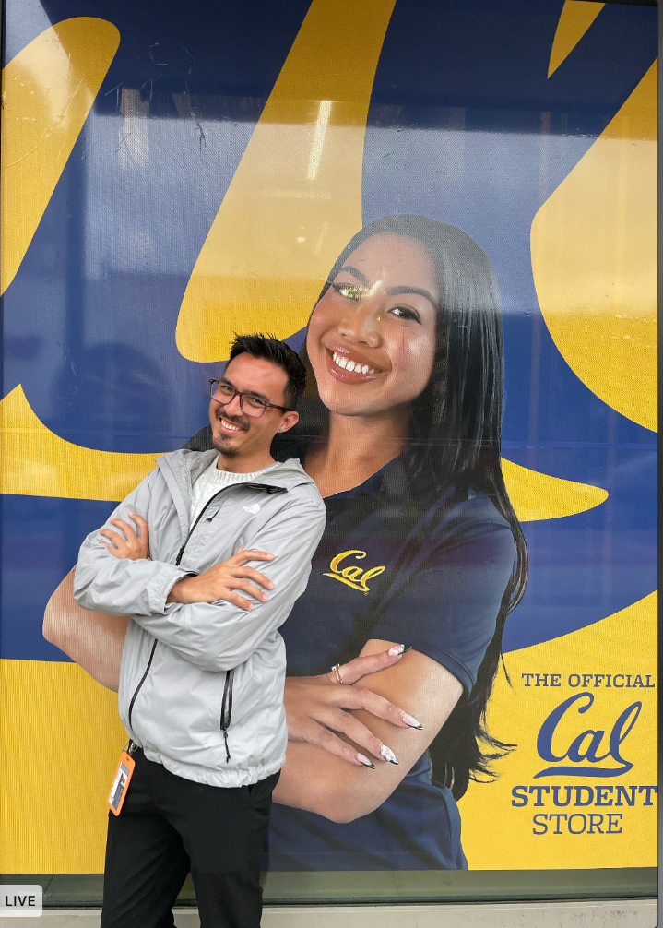

Slide 7
Questions?
Contact: president@asuc.org
bCal: abigailverino@berkeley.edu

