Slide 1

ASUC Office of the President Senate Announcements
Wednesday, Sept. 24th

Slide 2
Events/Committee Meetings
First South Asian Caucus meeting 9/19
CAA Distinguished Board Members meeting 9/22
Boston Walden Trust 9/22
Chancellor/VPAP Chief of Staff 9/22
OP Execs Meeting 9/22
Builders of Berkeley 9/23
OP x EVP x Amnesty 9/23

Slide 3
Upcoming Meetings/Events
Multicultural Initiative Fund Launch
IT Strategy Committee 9/25
Cal History, Spirit, and Traditions Decal 9/25
OP All-Staff 9/25
OP x CAA Planning 9/26
CACSSF Onboarding 9/26
OP x EVP Hunger Strike Solidarity Video 9/26
Headlands Brewery Connection Meeting

Slide 4

Office of the President Events
Notes:
Isa

Slide 5
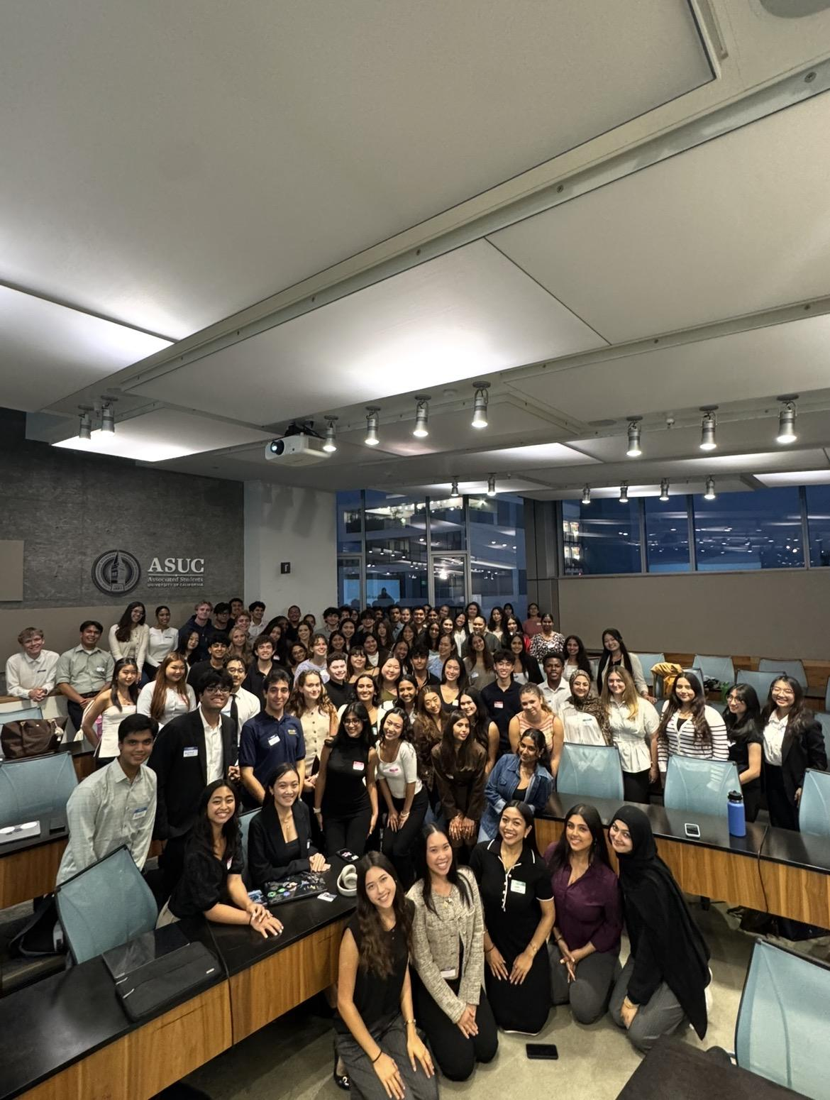
Highlights

Slide 6
Action Item
Senate Coffee Chats
OP x AAVP - Strategic Planning Committee

Slide 7
Questions?
Contact: president@asuc.org
bCal: abigailverino@berkeley.edu

