Slide 1

ASUC Office of the President Senate Announcements
Wednesday, Sept. 10th

Slide 2
Events/Committee Meetings
ASUC x GA Public Safety Committee: Self Defense Classes 9/9
ASUC Standing Meeting - Chancellor & Vice Chancellor 9/9
UDAR Meeting - MyBerkeley promo 9/8
Student Union Board of Directors Meeting 9/5
UC Council of Presidents Meeting 9/4
APISA UCOP FAHM Event
To do:
  Life Safety Committee Appointment

Slide 3
Upcoming Meetings/Events
Campus Memorial Event - Speaking Mon, 9/15 12-1pm Flagpole
CAC-LGBTQ+ – Call for Applications (2025–26)
  Open at-large positions for students, faculty, staff, and postdocs
  Purpose: Advise campus on LGBTQ+ community needs & promote inclusivity
  Commitment: 1-year term, 5–10 hours/month, renewable
  Past focus: Gender-inclusive restrooms, queer healthcare access, campus climate
  Deadline: Sept 17, 2025, 11:59 PM
  Questions / Apply: caclgbt@berkeley.edu / link

Slide 4
FLOCK Surveillance Cameras
Initial Inquiry
  ASUC President Verino asked if City of Berkeley FLOCK surveillance cameras (license plate recognition, LPR) are on campus.
Key Clarifications
Chief Pittman (UCPD):
  6 cameras exist, funded by Residential and Student Service Programs (RSSP)
  Located at University Village Albany (UVA) and Emeryville, not on central campus
  Cameras use LPR technology
  UCPD monitors them in real time
  City of Berkeley also uses LPR tech
Dave Browne (Campus IT):
  No FLOCK cameras connected to UC Berkeley’s IT-supported system (Genetec)
  One pilot camera installed at Wickson Gate, currently inactive

Slide 5
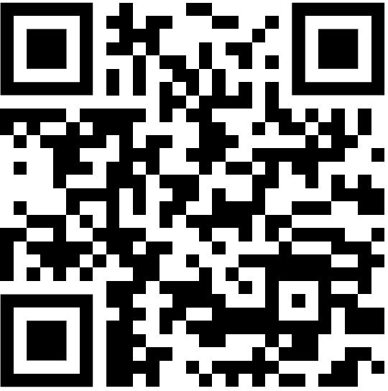
Action Item: Strategic Plan
Notes:
Isa

Slide 6
Questions?
Contact: president@asuc.org
bCal: abigailverino@berkeley.edu

