Slide 1

ASUC Office of the President Senate Announcements
Wednesday, February 11th

Slide 2
Updates!
Primary sponsor for EOP’s Wellness Fund Application
Working with P&T

Slide 3
Office of the President Events
~
APO Professional Development Workshop Series
  Begins Feb 17th - ESH 540
  ~7 week long series (ie. Cover Letters, Linked In, Case Interviews, etc.)
Undocumented & International Student Support
  Know Your Rights flyer distribution across dorms (important resource info)
  Advocacy efforts & legislation tracking supporting undocumented/international students
RSO & Student Org Support
  OP x EVP x CFO x OASIS RSO information session (Feb 25, if confirmed)
  Upcoming RSO rights & privileges one-pager release
Environmental Justice & Sustainability
  Community fridge collaboration (student-impact project)
  Social justice x sustainability educational graphic
  Reuse collaboration donation to environmental nonprofit
Commercial Activities
  Blood Drive - Feb 25
Microgrant Distribution Event
Yale Law School Panel x Former ASUC President Chaka Tellem
Notes:
Isa

Slide 4
Past Events
Upcoming Events
UBPS Committee 2/9
Dean of Students Connect 2/9
SAAC Meeting 2/10
ASUC Execs & Appointeds 2/11
ASUC x Chancellor’s Cabinet 2/11

Slide 5
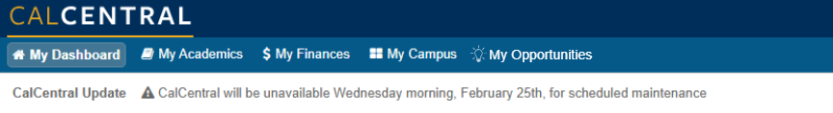
Quick Poll
Do you know what the Discovery Database is?
Imagine Cal Central with this…
Thoughts? Questions? Comments? Concerns?

Slide 6
Questions?
Contact: president@asuc.org
bCal: abigailverino@berkeley.edu

