Slide 1

ASUC Office of the President Senate Announcements
Wednesday, January 21st

Slide 2
Office of the President Events
ASUC Info Session (OP x CCO)
  Tuesday, January 27th, 6:30-8:00pm
  Wednesday, January 28th, 7:00-8:00pm
Community Centers Microgrant Distribution Event
  Friday, February 20th, 4:00-6:00pm
Notes:
Isa

Slide 3
Past Events
Upcoming Events
Winter Inter-Semester Committee 1/12
ASUC CASSA Committee 1/12
Council of Presidents - UC Office of the President 1/13
ASUC Alumni & Donor Relations 1/13
ASUC Budget Committee 1/14
Spring GBO Session - Student Life 1/16
EVP x CFO x CLO 1/19
RecWell x ASUC 1/21
Execs & Appointeds 1/21
Haas Public Service Award Committee Meeting 1/22
ASUC/VPUE/AVC of Enrollment/Registrar Meeting 1/22
OP All-Staff 1/22
ASUC Winter Conference 1/24
Council of Presidents 1/25
Pilipinx Academic Student Orientation 1/25
ASUC/GA x CoS/VC Check-In 1/26
ASUC x VPAP 1/26
UBPS Advisory Committee 1/27
IT Strategy 1/28

Slide 4
UC Council of Presidents Recap
Student Health & UC Ship Updates
  Provider shortages, third-party billing, rise in suicide cases
President Millikan Remarks
  Pushed to reinstate quarterly meetings with the President (success!)
Community Safety
  Implementation of SB 98 - SAFE Act
  Police Accountability Board, LPR’s
Student Regent Nominations
  Trustee’s for the UC System
UC Budget
  $56 million, $350 million awarded by Gov. Newsom to be dispersed in 2 year period
Basic Needs
  UC Basic Needs Initiative, UC Equity in Mental Health Initiative, UC Disability Services

Slide 5
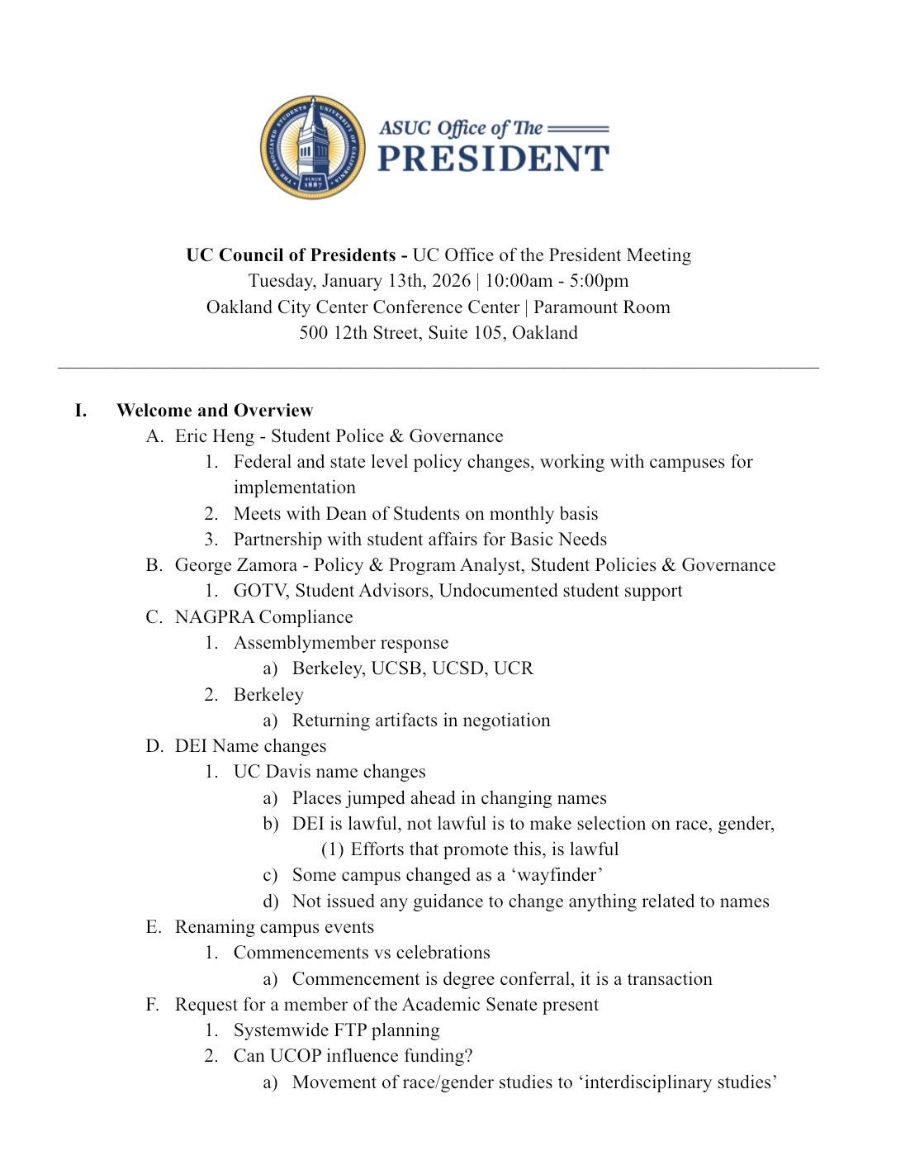
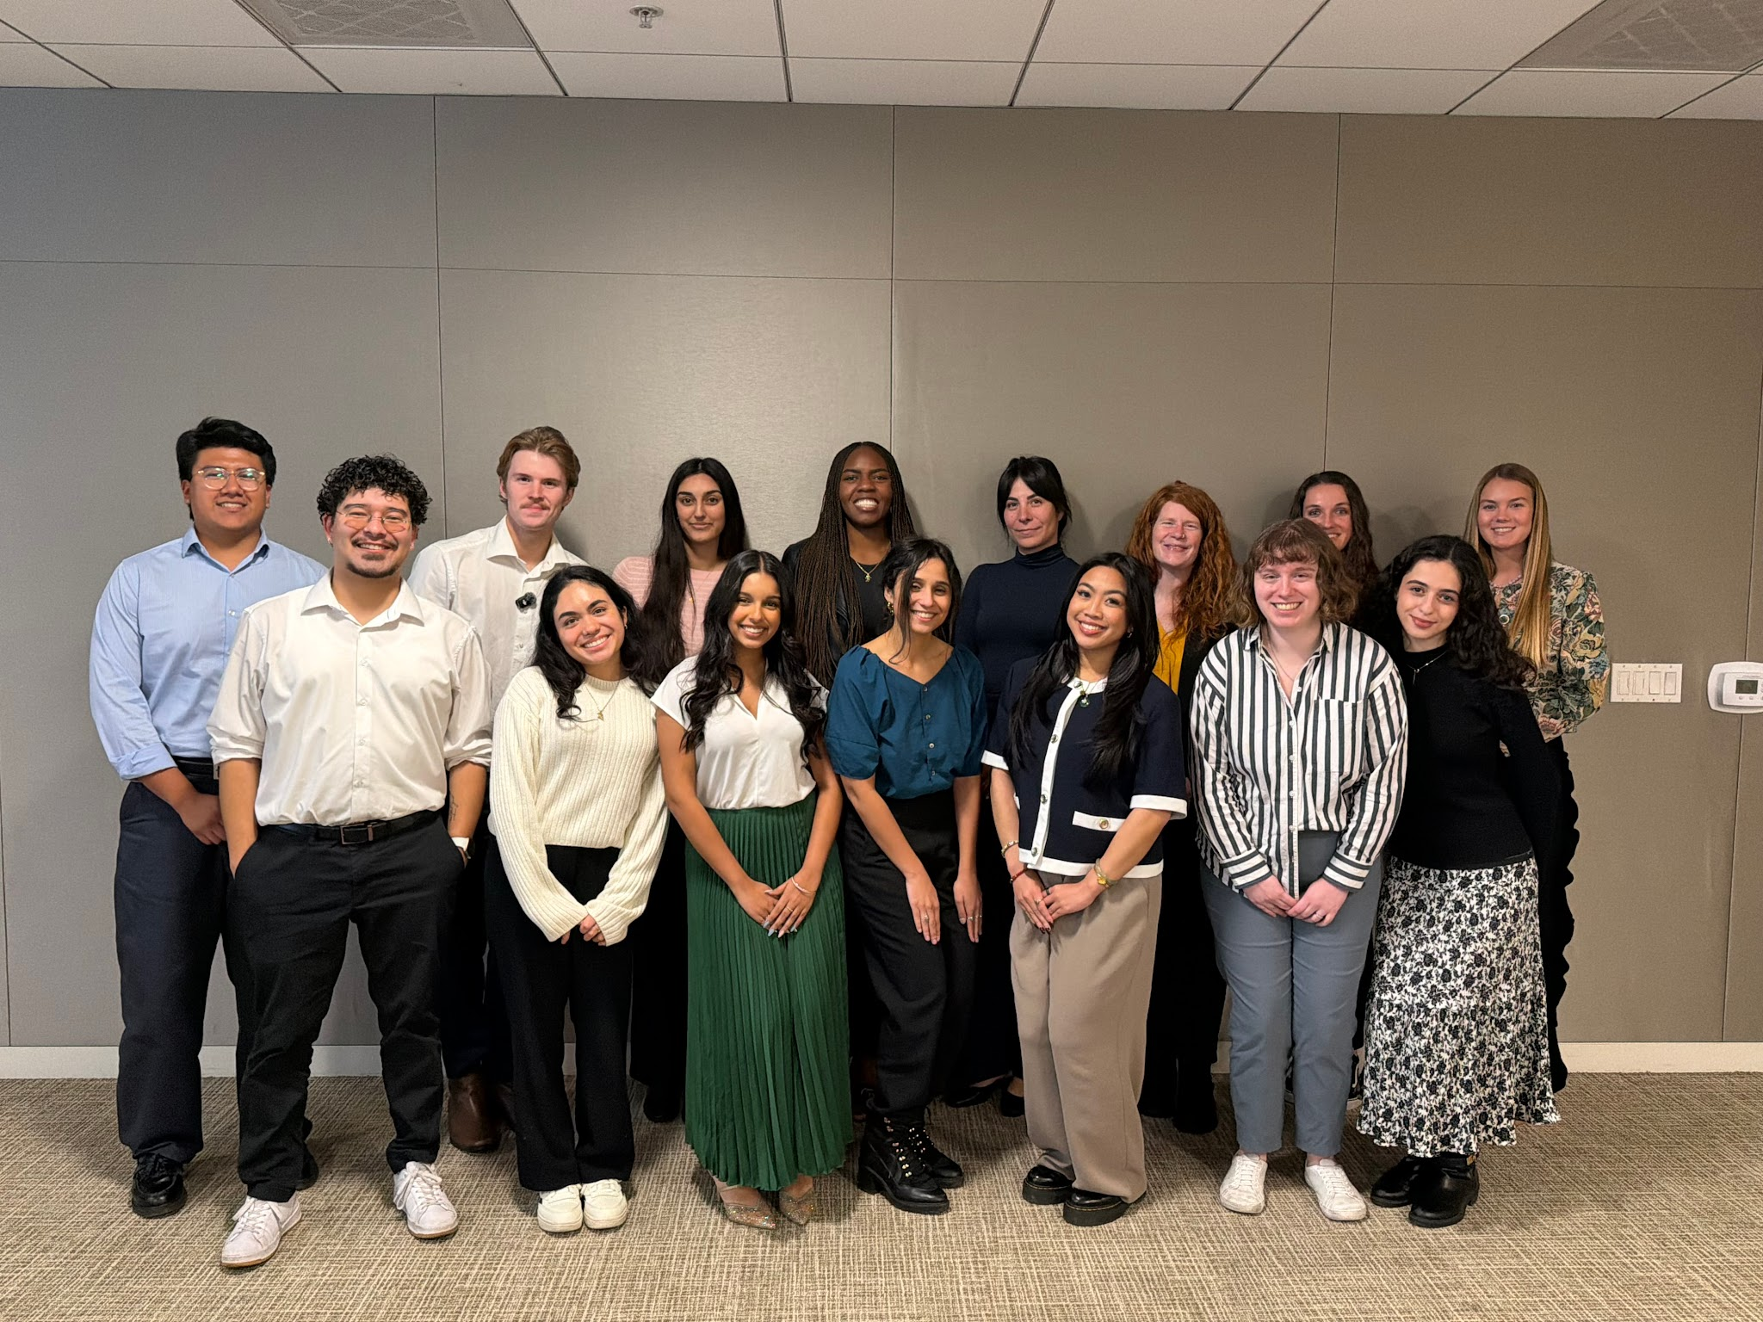
UC Council of Presidents Recap

Slide 6
Action Item!
Fill out your slide for ASUC Info Sessions & please email myself & Gigi designees/if you will not be in attendance!
Scheduling

Slide 7
Questions?
Contact: president@asuc.org
bCal: abigailverino@berkeley.edu

