Slide 1

4/1 CPO
Senate
Updates
Chief Personnel Officer
Shelby Coleman

Slide 2
Updates
01
02
04
03
SU Board
Commissions
Successors for 8/9 commissions have been selected
Pending USAC nominations
Interviews to be held Friday 4/10 to select new undergraduate member
Judicial Council
Succession Summit
Tuesday, April 21st moved to 4:30-6:30pm (moved up one hour)
in Senate Chambers (bCal sent!)
All outgoing/incoming Execs/Appointeds, Senators/TSR, and Commission Chairs
Timeline to be announced soon for open seats

Slide 3
Updates
01
02
03
Goggles w/OCTO
Impact Tracker
Working on streamlined application systems for next year’s recruitment
Continue to fill out everytime you host an event/complete an initiative
In bCourses!
Spring Mid-Year Report
Were due Friday, 3/27 (Friday of Spring Break)
Submit ASAP if you haven’t already
**For Senators: Week 12 & 14 only regular reports left!!
End-of-year report will be opened at the end of the month

Slide 4
End of year Banquet!
01
02
ASUC BANQUET!
Nominations
Wednesday May 6th at 7pm
Sequoia Room, Anchor House
Theme: A Night on the Red Carpet
Please RSVP ASAP and forward to your staff members/offices
Nominate yourself/your peers for awards and superlatives
Deadline extended to April 10th!
Link for nomination form in the invite email

Slide 5
2026-27 Chief Appointed Officials
Thank you Somer, Josh, and Sara!

Slide 6
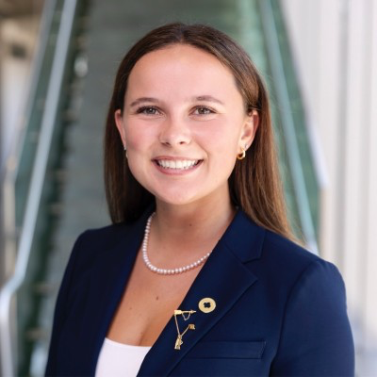
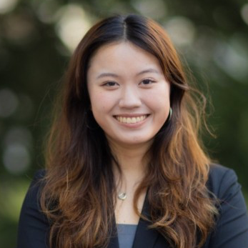
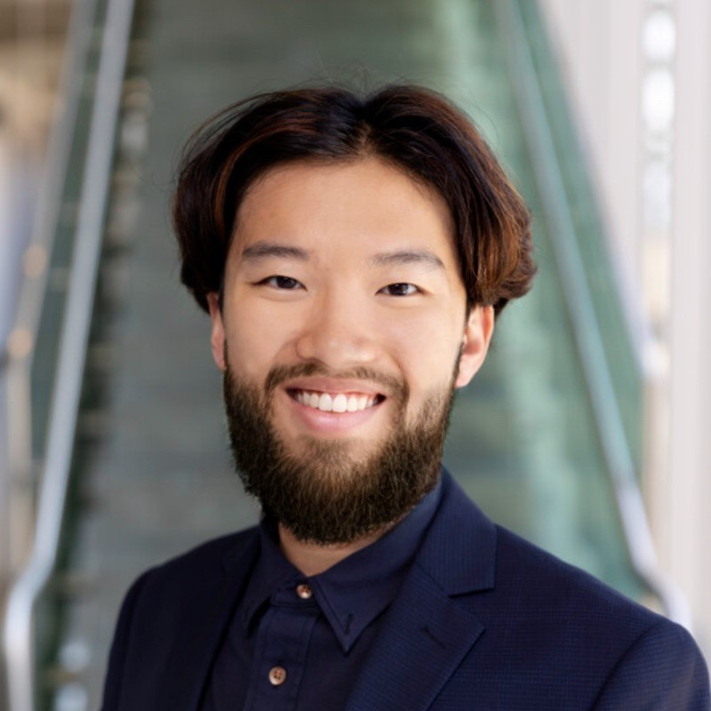
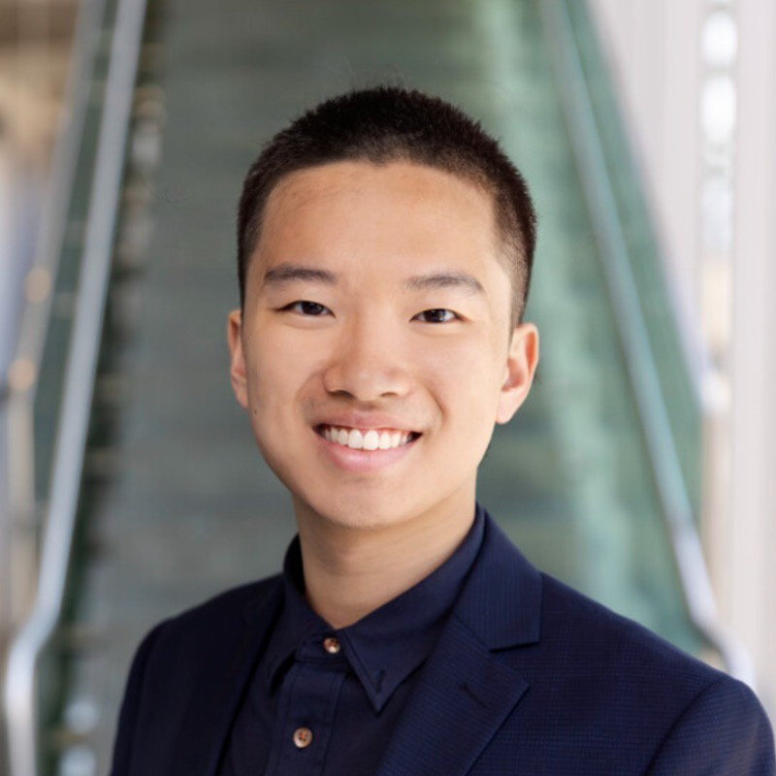
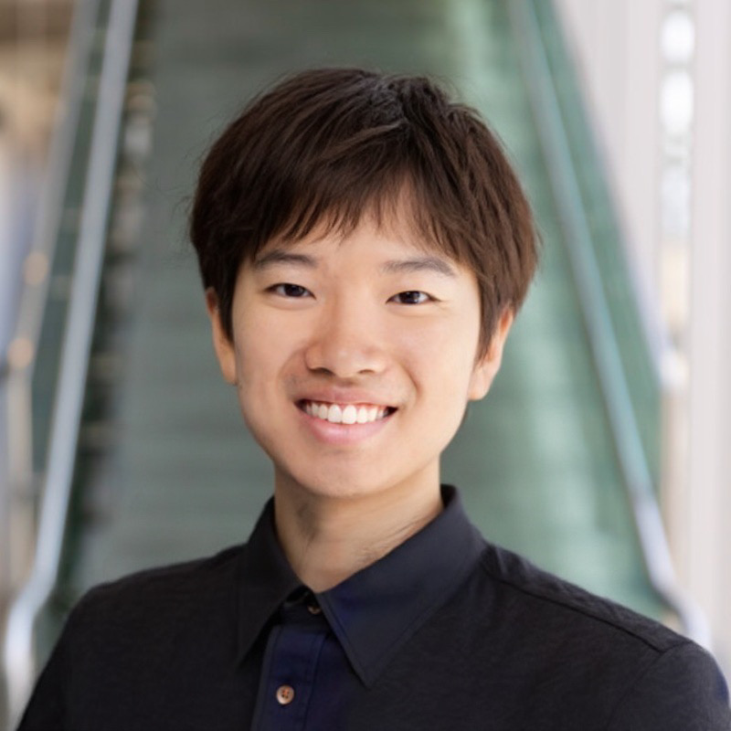
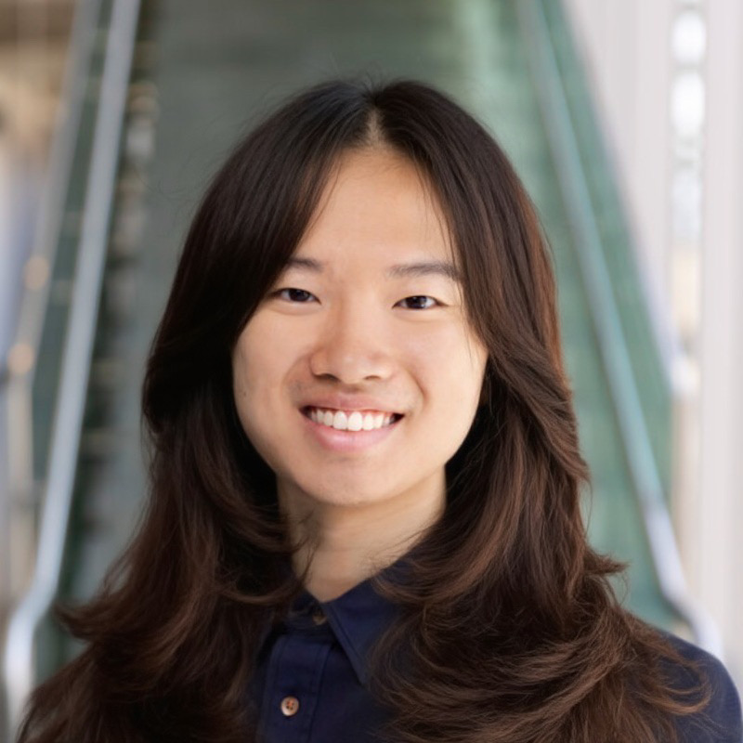
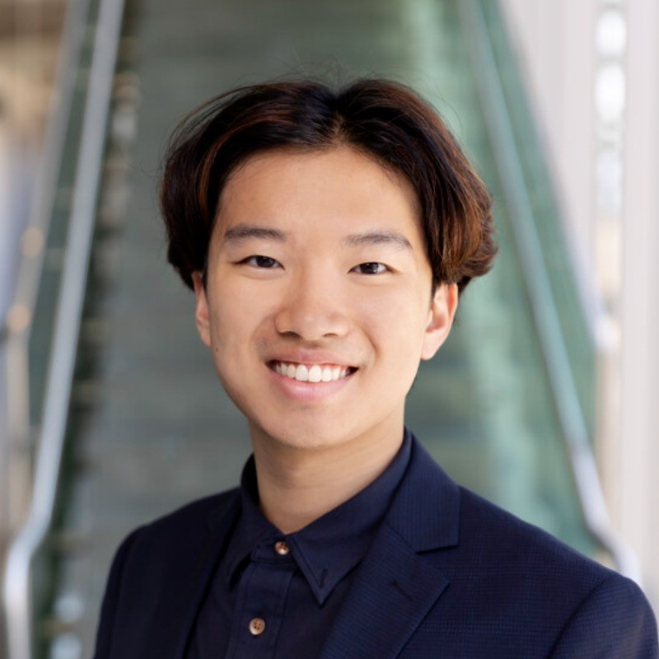
2026-27 Chief Appointed Officials
FINANCIAL
Jonathan Ngai

Slide 7
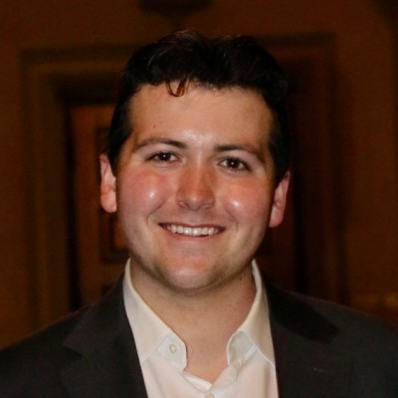
2026-27 Chief Appointed Officials
FINANCIAL
Jonathan Ngai
LEGAL
Jonathan Ngai

Slide 8
2026-27 Chief Appointed Officials
FINANCIAL
Jonathan Ngai
LEGAL
Jonathan Ngai
PERSONNEL
Jonathan Ngai

Slide 9

2026-27 Chief Appointed Officials
FINANCIAL
Jonathan Ngai
LEGAL
Jonathan Ngai
PERSONNEL
Jonathan Ngai
COMMS
Jonathan Ngai

Slide 10
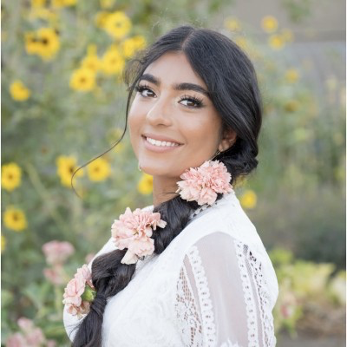
2026-27 Chief Appointed Officials
FINANCIAL
Jonathan Ngai
LEGAL
Jonathan Ngai
PERSONNEL
Jonathan Ngai
COMMS
Jonathan Ngai
TECH
Jonathan Ngai

Slide 11
2026-27 Chief Appointed Officials

Slide 12
2026-27 Chief Appointed Officials
FINANCIAL
Monique Hui

Slide 13
2026-27 Chief Appointed Officials
FINANCIAL
Monique Hui
LEGAL
Daniel Dolan

Slide 14
2026-27 Chief Appointed Officials
FINANCIAL
Monique Hui
LEGAL
Daniel Dolan
PERSONNEL
Sydney Scott

Slide 15
2026-27 Chief Appointed Officials
FINANCIAL
Monique Hui
LEGAL
Daniel Dolan
PERSONNEL
Sydney Scott
COMMS
Juliette Diaz Rackohn

Slide 16
2026-27 Chief Appointed Officials
FINANCIAL
Monique Hui
LEGAL
Daniel Dolan
PERSONNEL
Sydney Scott
COMMS
Juliette Diaz Rackohn
TECH
Simar Kaur

Slide 17
#girlpower!!!!
X
FINANCIAL
Monique Hui
LEGAL
Daniel Dolan
PERSONNEL
Sydney Scott
COMMS
Juliette Diaz Rackohn
TECH
Simar Kaur

Slide 18

Thank you!
Reminder: always welcome to bCal me! Questions or just to chat :)
Contact via personnel@asuc.org,
bCal shelbycoleman@berkeley.edu

